Slide 1

SLIC POC
Initial Data Retrieval process
&
Underwriting process

Slide 2

Systems Involved
B – Insurance [Postal Insurance + SLIC]
B – Third Party

Slide 3
PART 1 - Data Retrieval;
Download not uploaded records from postal system.
Upload the same into the postal insurance system.
Extract data from each unprocessed transaction item to an excel sheet.
Navigate to Motor Third Party System and check whether any policies are defined for the unprocessed vehicle numbers.
If a policy is defined, then go to the next step.

Slide 4
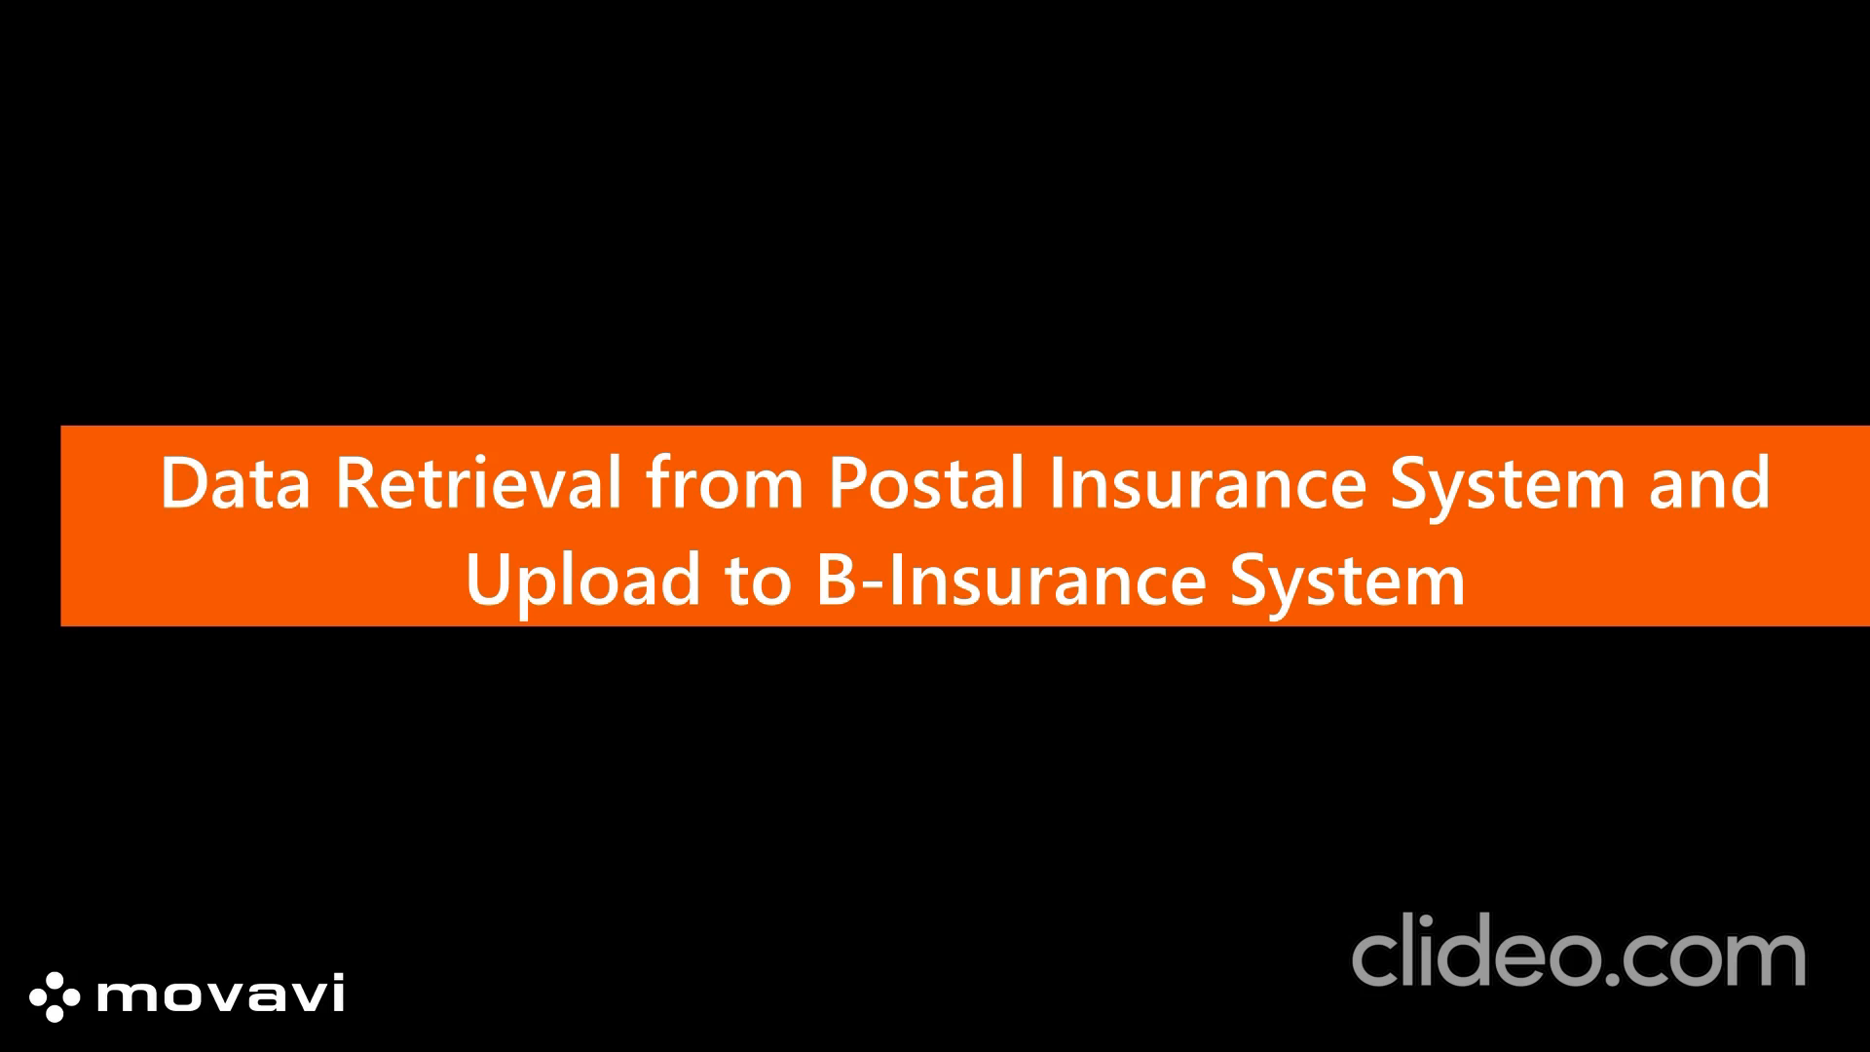
PART 1

Slide 5
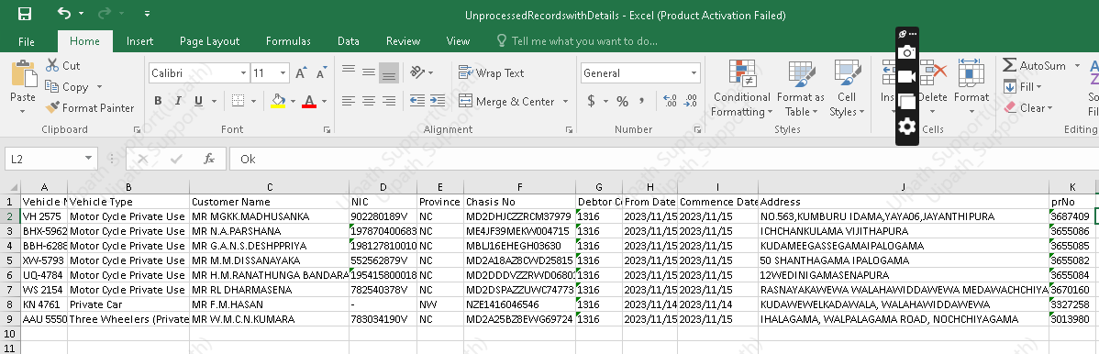
Output : Excel Sheet after executing Part 1

Slide 6
Case 1 : If a certain vehicle number doesn’t contain any pre-defined policy;
Search for NIC
Enter the correct details of the policy holder to the system.
Create a new business.

Slide 7
Case 2 : If a certain vehicle number contains a pre-defined policy and names are similar;
Renew the policy

Slide 8
Exceptions :
If names do not tally / Non-Compliance with the Policy within a Designated Timeframe;
Search for NIC
Enter the correct details of the policy holder to the system.
Create a new business.

Slide 9
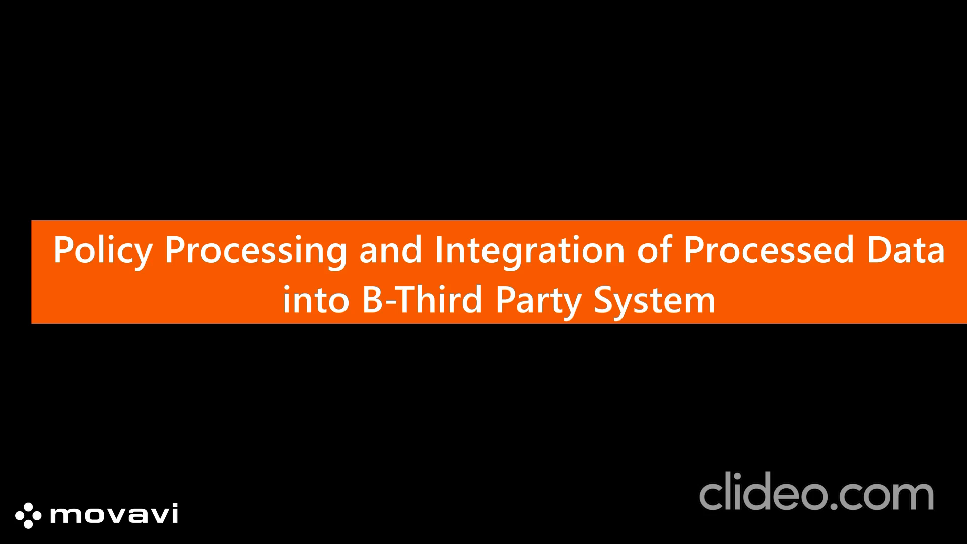
PART 2

Slide 10
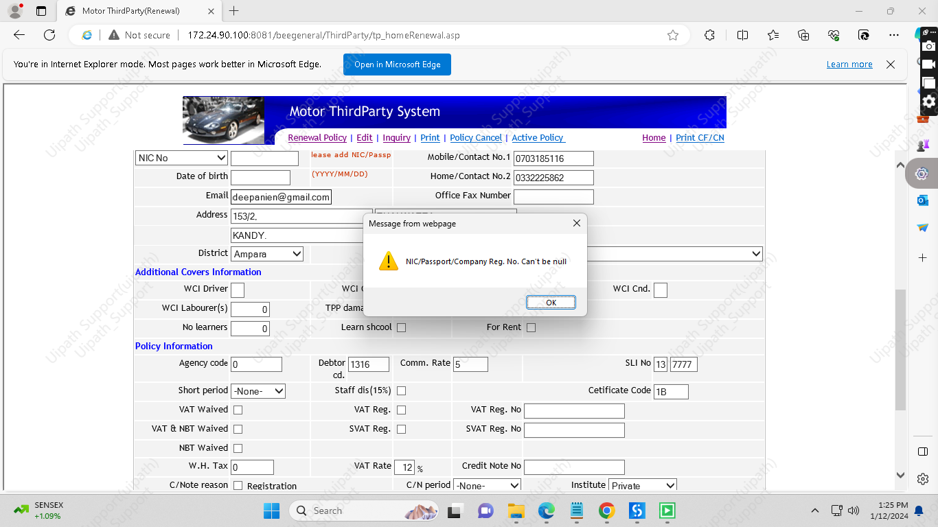
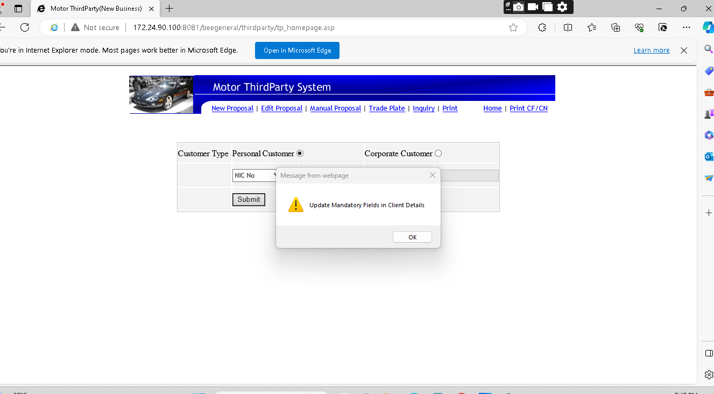
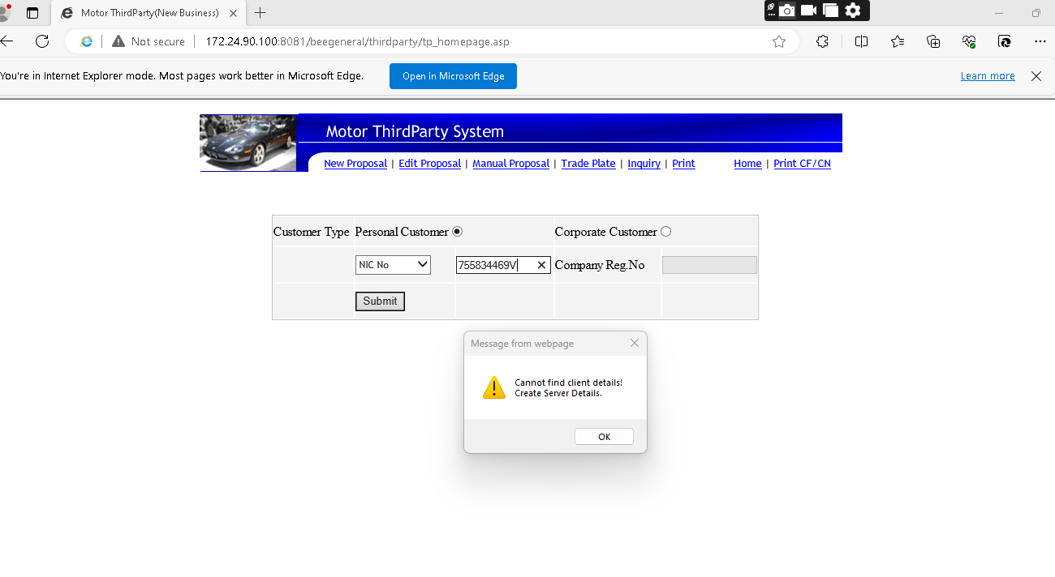
Challenges Faced ;
No NIC given – when creating new businesses.
No Chasis number given
Formatting of address

Slide 11
Suggestions
Validation parts to be carried out by an internal team using the excel.
address , NIC , Chassi Number formatting
Validated records to be utilized in policy processing workflow.

